Slide 1
How to make earrings from PET bottles

Slide 2
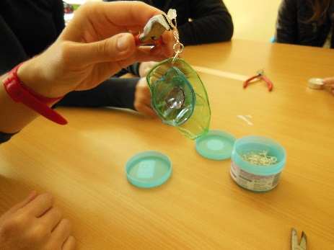
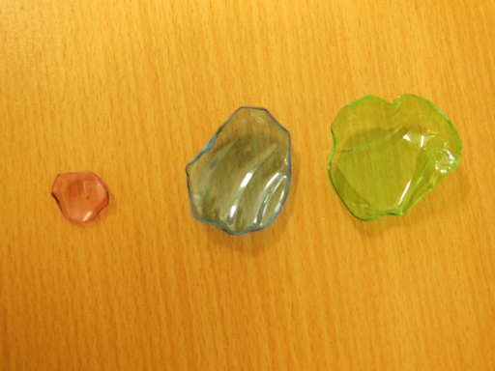
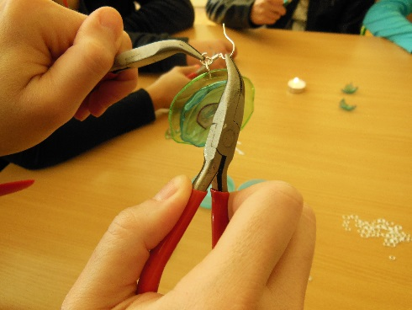
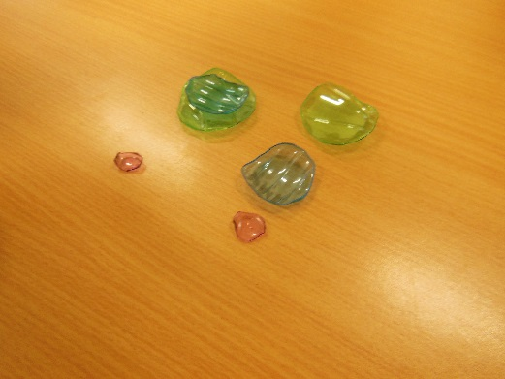
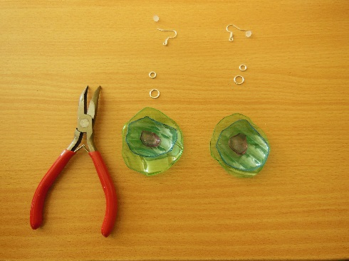
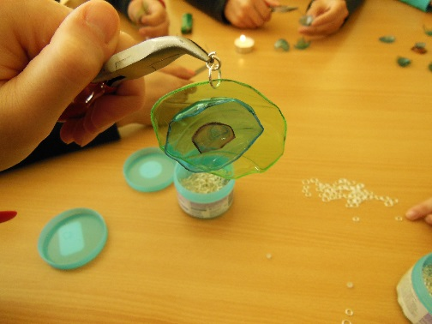
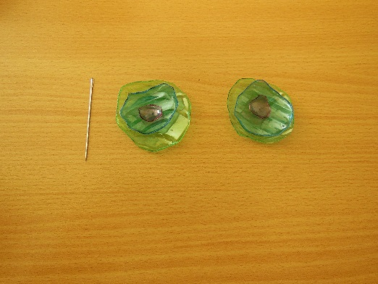
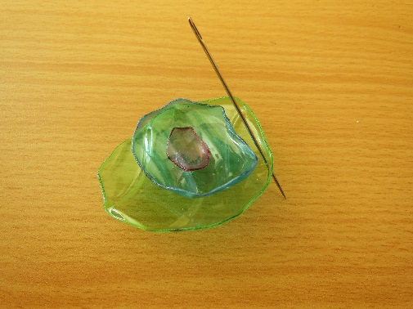
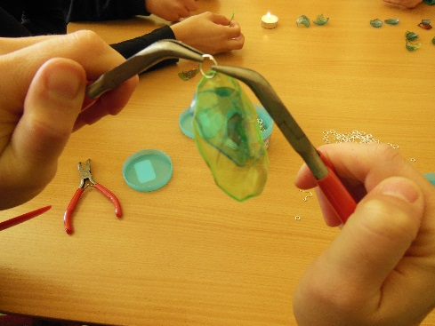
We need:
Empty PET bottles
Scissors and pliers
Candle and lighter
Glue and pin
Small and big rings
Earring hooks

Slide 3
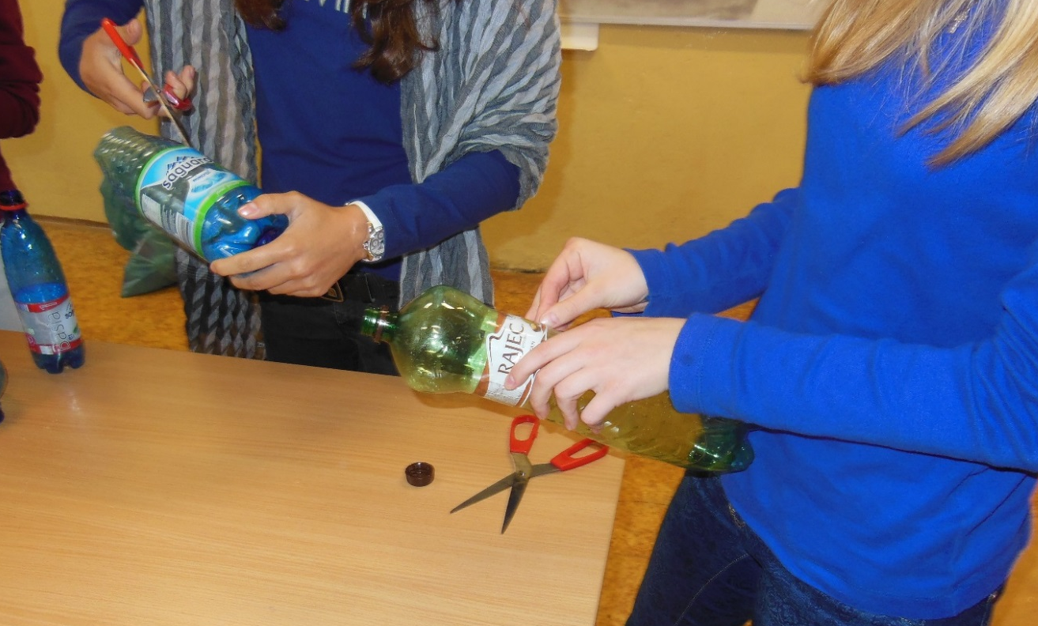
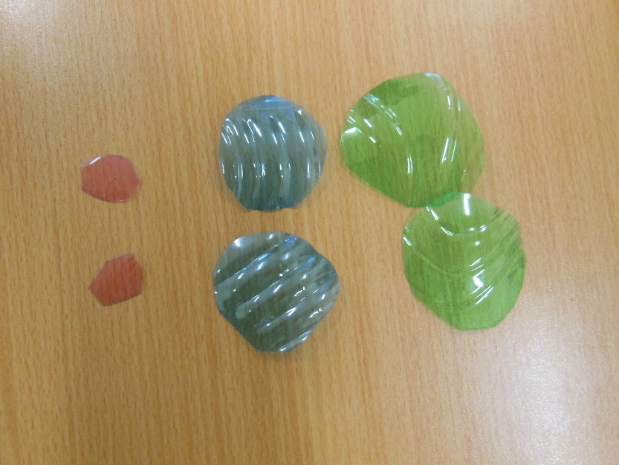
1. Cut small circles different size and different collors from PET bottles.

Slide 4
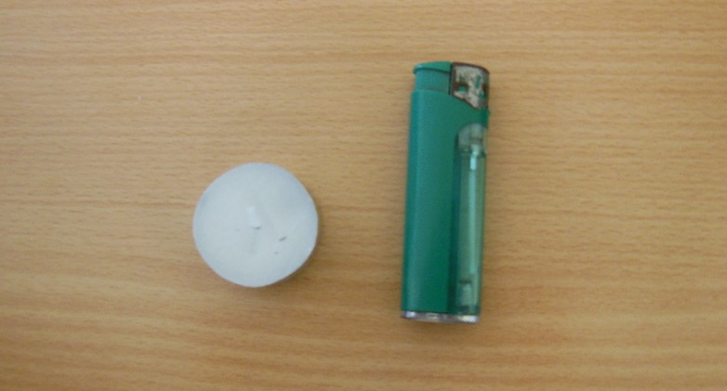
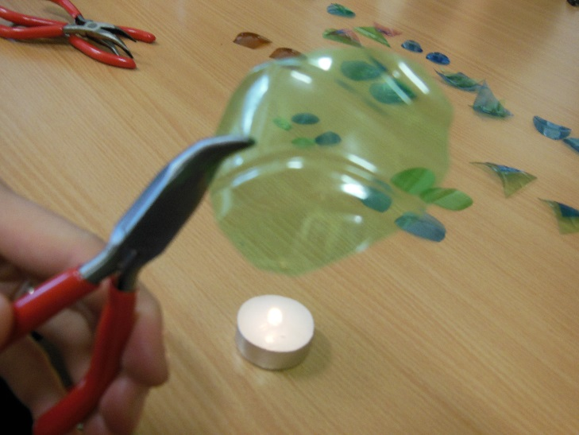
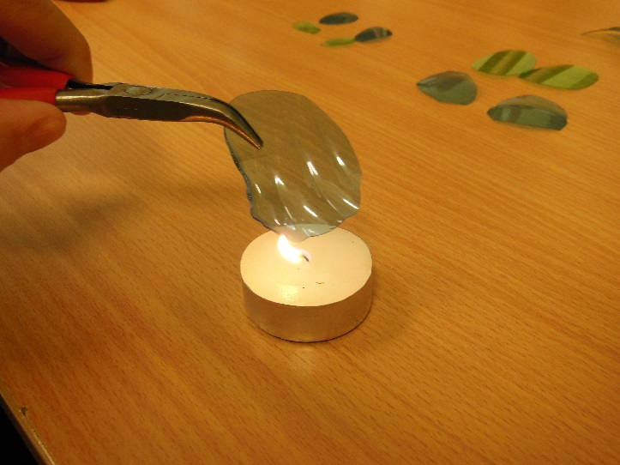
2. Light the candle, take the circles with the pliers and warm them on the fire.

Slide 5
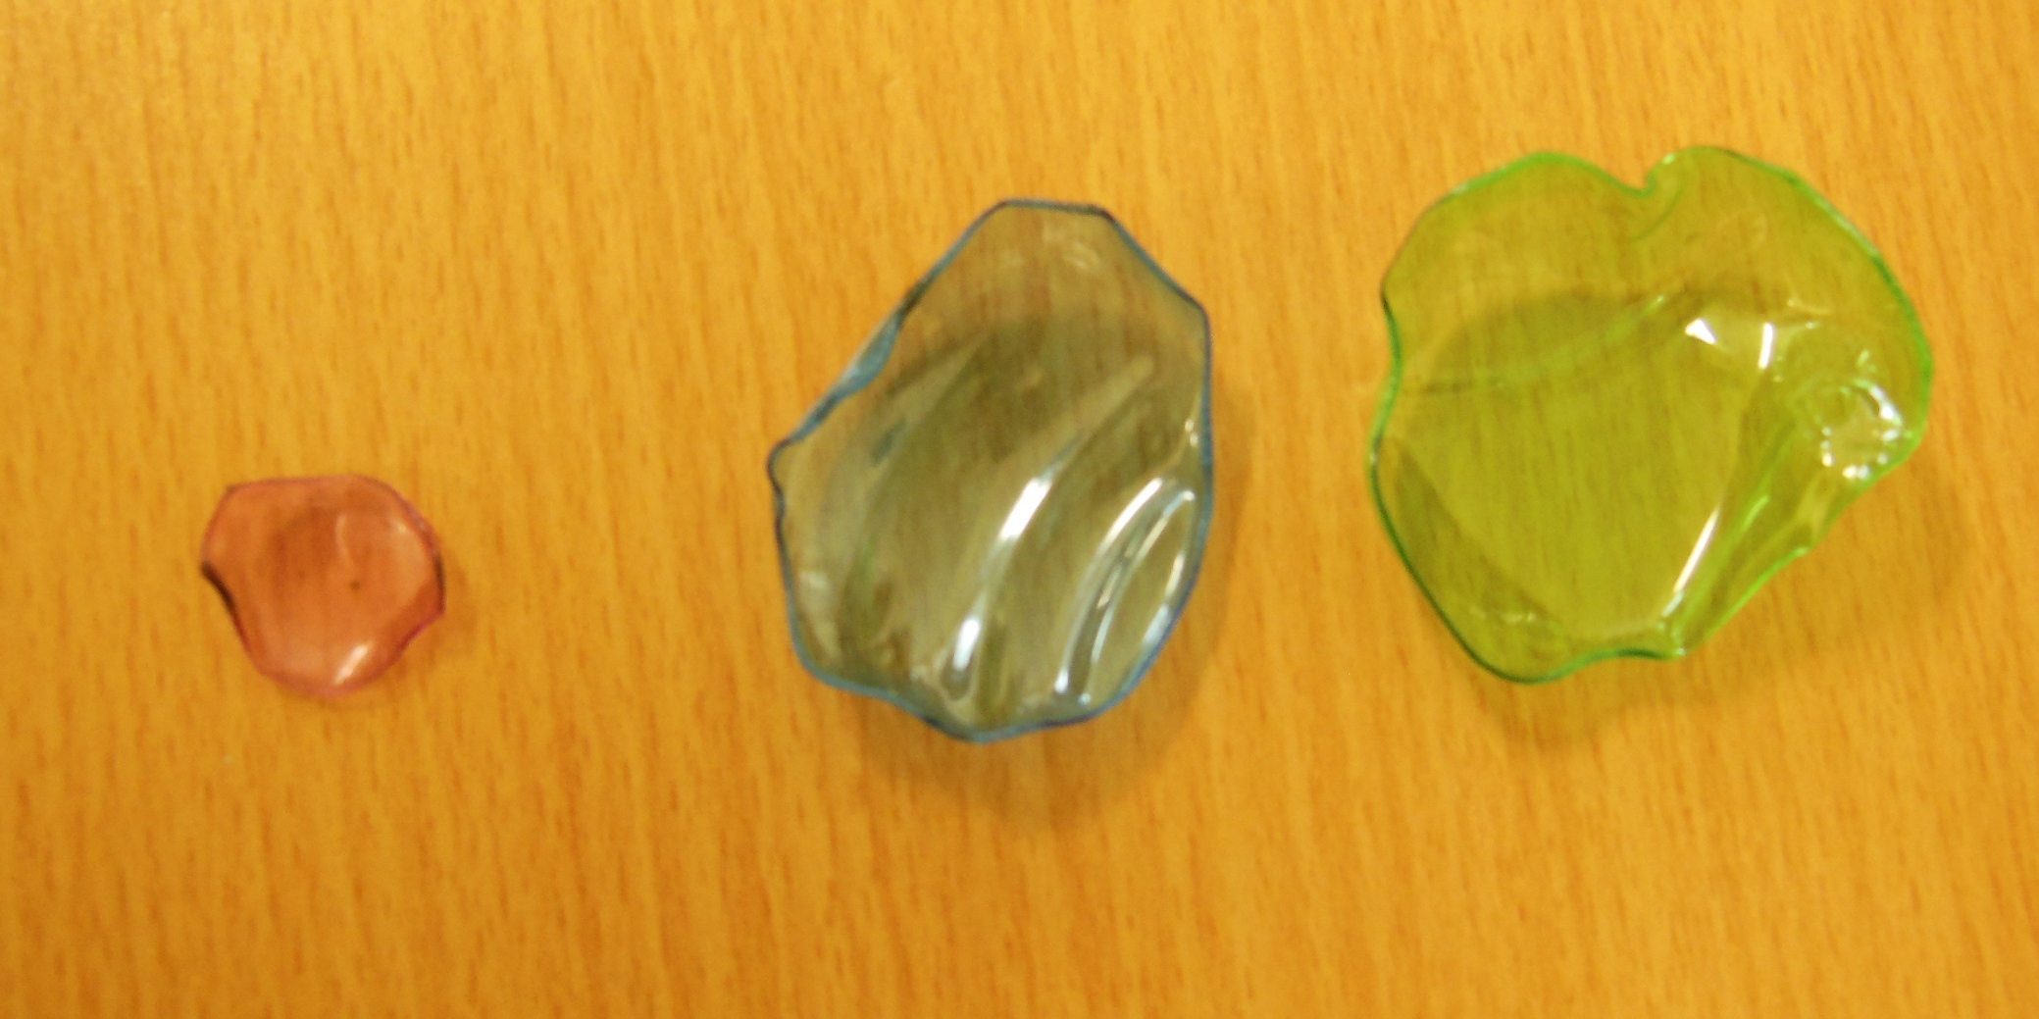
After warming

Slide 6
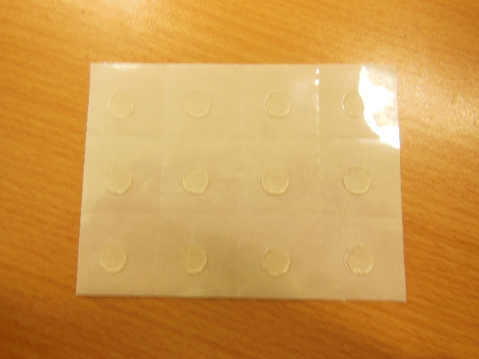
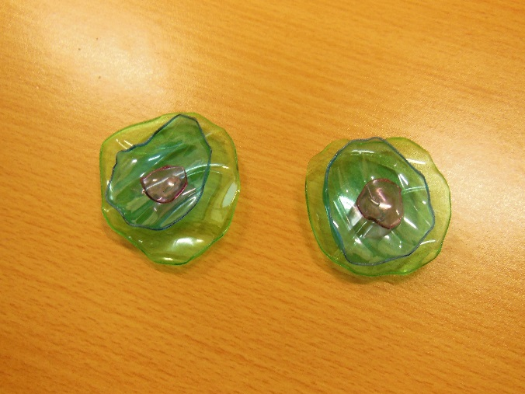
3. Stick the plastic circles together with special glue.

Slide 7
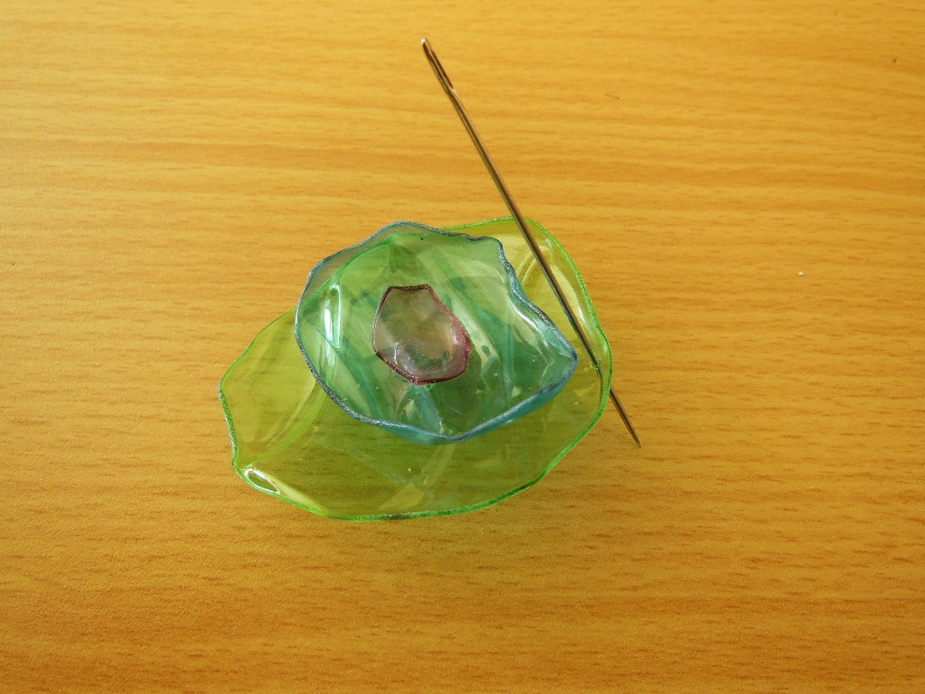
4. Pierce the top of the earring with a pin.

Slide 8
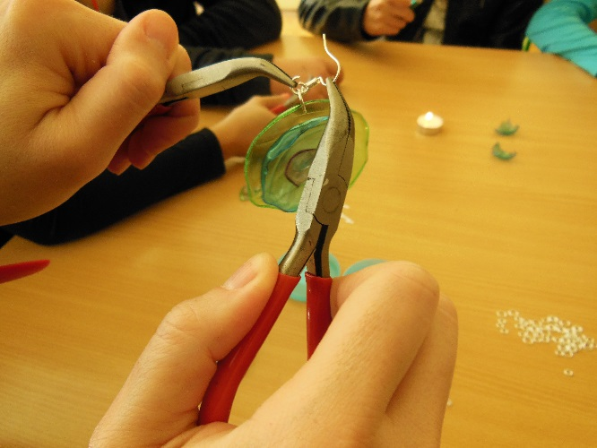
5.Put a bigger metal ring into the hole, then smaller one.

Slide 9
6. Put a hook in the smaller ring in the earring.

Slide 10
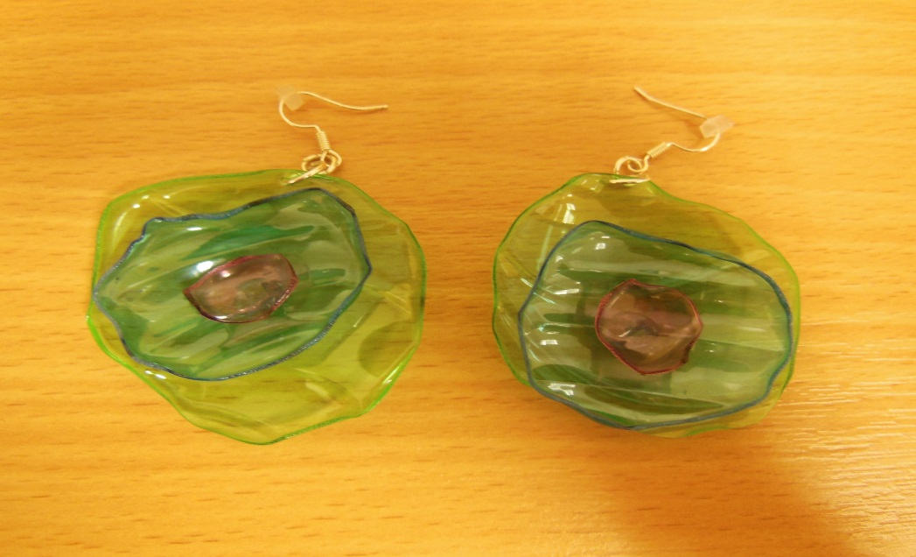
Earrings are ready!

Slide 11
Thanks for your attention.
Martina Pepuchová and Michaela Nemcová

